Slide 1

JSP Standard Tag Library-JSTL

Slide 2
Objectives
This session is learning about the JSTL:
  What JSTL is
  Why do we use it
  Tag libraries included in JSTL
  A detailed glance to the JSTL-core library
  The other libraries and their functions
  How to use the JSTL in a project

Slide 3
What JSTL is?
JSTL (JSP Standard Tag Libraries) is a collection of JSP custom tags developed by Java Community Process, www.jcp.org.
The goal of JSTL is to help simplify JavaServer Pages page authors' lives. To achieve this goal, JSTL has provided custom tags for many common JSP page authoring tasks that require scripting statements to manipulate server side dynamic data.

Slide 4
What JSTL offers?
General-purpose actions: Displaying, scope, setting and removing jsp scoped attributes, catching exceptions.
Control flow actions: Conditional, iterators…
Tag library validators: TLVs allow projects to only allow specific tag libraries, as well as enforce JSP coding styles that are free of scripting elements

Slide 5
What JSTL offers? (2)
The other key aspects of JSTL are:
  ■ Accessing URL-based resources
  ■ Internationalization (i18n) and text formatting
  ■ Relational database access (SQL)
  ■ XML processing
  ■ String manipulation

Slide 6
JSTL Tag Libraries
Functional Area | URI | Prefix
Core | http://java.sun.com/jsp/jstl/core | c
Xml Processing | http://java.sun.com/jsp/jstl/xml | x
I18N capable formatting | http://java.sun.com/jsp/jstl/fmt | fmt
Relational database accesing (SQL) | http://java.sun.com/jsp/jstl/sql | sql
Functions | http://java.sun.com/jsp/jstl/functions | fn

Slide 7
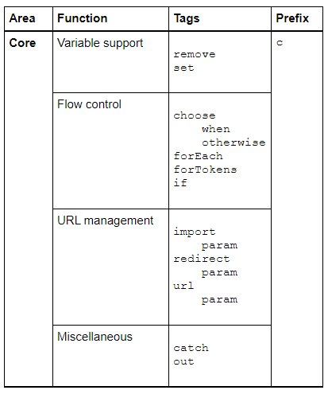
Core tags

Slide 8
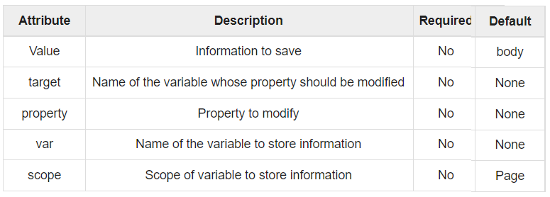
Variable support tags
The set tag sets the value of an EL variable or the property of an EL variable in any of the JSP scopes
  var : for setting attribute variable. it is created if not exist
  target : for setting bean properties or map values, property must also be specified.(never have both var, target attributes)

Slide 9
Variable support tags
Example
  Set value of variable from expr value :
  <c:set var="foo" scope="session" value=“${x+y}"/>
  Set value of variable from the body of the tag:
  <c:set var="foo"> ${x+y} </c:set>
  Set an EL variable named bookID with the value of the request parameter named bid:
  <c:set var="bookId" value="${param.bid}"/>
  Setting a target property of a map
  <c:set target="${map}" property=“key" value=“xyz"/>
  Setting a target property of a bean with body tag
  <c:set target="${person}" property="name">
  ${param.fullname}
  </c:set>

Slide 10
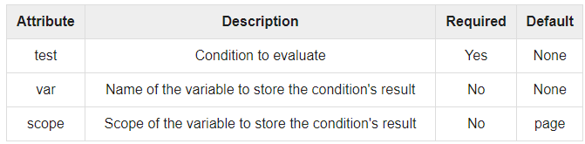
Flow Control Tags
Flow control tags eliminate the need for scriptlets
The <c:if> tag evaluates an expression and displays its body content or execution of its body only if the expression evaluates to true
    <c:if test=”..” var=”..” scope=”..”>
    ..
    </c:if>

Slide 11
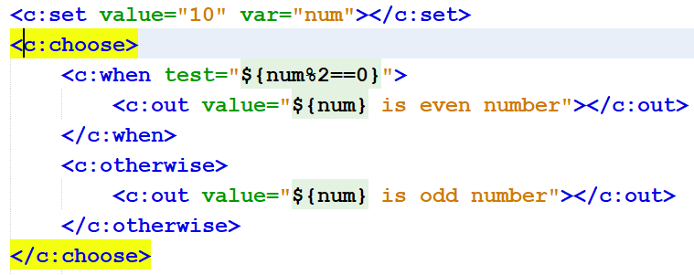
Flow control tag: conditional
<c:choose> works like a Java switch statement.
  <c:when test=“condition”> tags like case, at least 1.
  <c:otherwise> tag like default, optional
  c:when and c:otherwise must be placed inside c:choose tag, c:otherwise must be placed last.

Slide 12
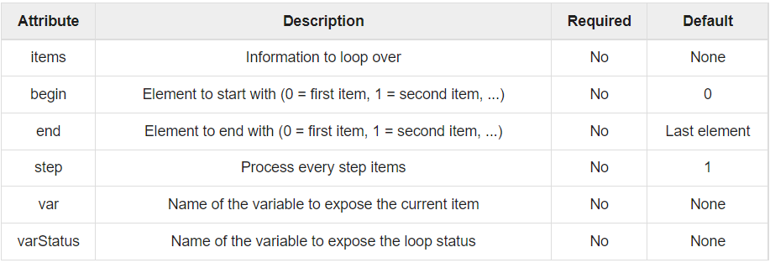
Flow control tag: Iterator
An alternative to for, while, or do-while loop
<c:forEach items=“..” var=“..”> tag used to iterate over a collection of objects.
  Items attribute: collection, var attribute: current item

Slide 13


Flow control tag: Iterator
use begin, end, step to perform iterations which start/end at a particular index or step over items, varstatus to get LoopTagStatus
<c:forTokens > used to break a string into tokens and iterate over a collection of tokens separated by a delimiter
  additional attribute delims for delimiter

Slide 14
Miscellaneous Tags
<c:out> evaluates an expression and outputs the result to the current JspWriter object
  similar to the way <%= %> works
  <c:out value=“expression” default=“…”/>
To remove an EL variable, you use the remove tag.
  <c:remove var="cart" scope="session"/>
<c:catch> risky code</c:catch> used to catch and prevent exception
  can hold the raised exception object by using var attribute
  <c:catch var="e"> <% int age=Integer.parseInt("ten"); %>
  The Raised Exception : ${e}
  </c:catch>

Slide 15
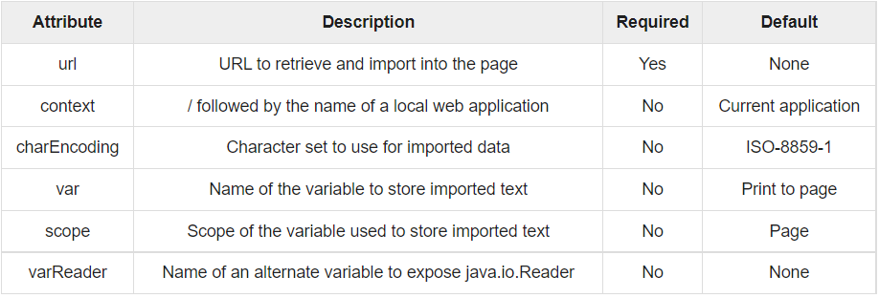
Import tag
<c:import> tag provides all functionalities of <jsp:include> action but also allows absolute URLs.
<c:import url=“resource address” >
<c:import var="webData" url="http://www.google.com"/>

Slide 16
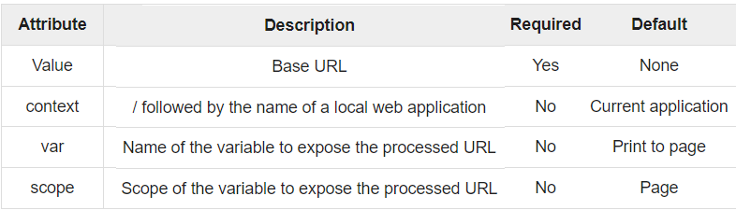
URL tag
  <c:url value=“..”> tag enable session tracking whenever the client turns off cookies.
    alternative for response.encodeURL() method.
  <c:redirect url=‘..’> redirects the browser to an alternate URL by facilitating automatic URL rewriting
  Import, url, redirect can use <c:param name=“..” value=“..”/> to supply request parameters and values

Slide 17
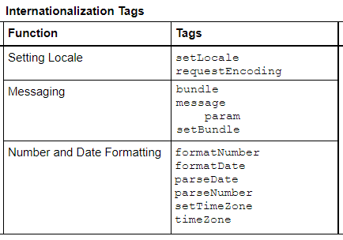
Internationalization(i18n)
I18N tags use a localization context to localize their data. A localization context contains a locale and a resource bundle instance.

Slide 18
Internationalization(i18n)
URI: http://java.sun.com/jsp/jstl/fmt ,prefix=“fmt”
  <fmt:setLocale>: used to store the given locale in the locale configuration variable.
  <fmt:bundle>: tag will make the specified bundle available to all <fmt:message> tags that occur between the bounding <fmt:bundle> and </fmt:bundle> tags. With this, you need not specify the resource bundle for each of your <fmt:message> tags.
  <fmt:setBundle>: used to load a resource bundle and stores it in the named scoped variable or the bundle configuration variable.
  <fmt:message>: tag maps key to localized message and performs parametric replacement.
  <fmt:param>: set parameter values ​​for messages with parameters.
  <fmt:requestEncoding>: used to specify the encoding type used by forms that post data back to the Web application.

Slide 19
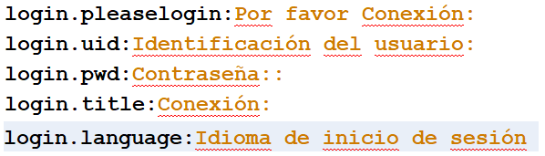
Internationalization(i18n)
Steps to i18n page content
  Create properties file for each locale (key-value)
    Name the file: bundle_es.properties (Spanish language)
    Save the file in package bundle
  Using formatting tags for i18n
    <fmt:setLocale value="es_ES"/>
    <fmt:setBundle basename="bundle" />
    <fmt:message key="login.pleaselogin"/>
  Add Jar/Folder references package bundle in Library

Slide 20
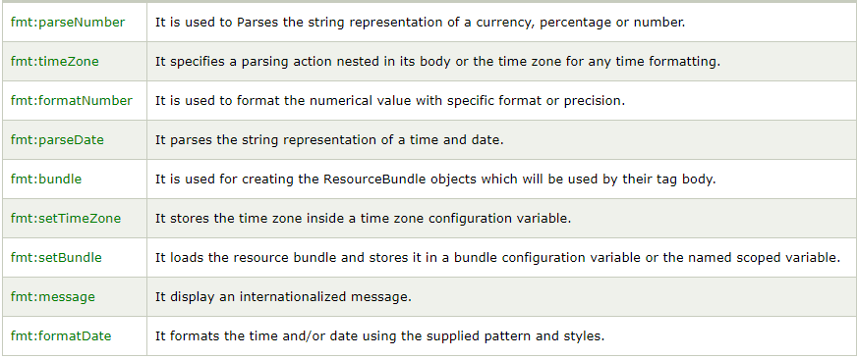
Formatting Tags
URI: http://java.sun.com/jsp/jstl/fmt ,prefix=“fmt”

Slide 21
SQL Actions
URI: http://java.sun.com/jsp/jstl/sql, prefix=“sql”
  <sql:query>
  <sql:update>
  <sql:transaction>
  <sql:setDataSource>
  <sql:param>
  <sql:dateParam>

Slide 22
XML Tags
URI: http://java.sun.com/jsp/jstl/xml, prefix=“x”
  <x:parse>
  <x:out>
  <x:set>
  <x:if>
  <x:choose>, <x:when>, <x:otherwise>
  <x:forEach>
  <x:transform>
  <x:param>

Slide 23
Functions Tag Library
URI: http://java.sun.com/jsp/jstl/functions, prefix=“x”
  <fn:contains>
  <fn:containsIgnoreCase>
  <fn:endsWith>
  <fn:escapeXml>
  <fn:indexOf>
  <fn:join>
  <fn:length>
  <fn:replace>
  <fn:split>
  <fn:startsWith>
  <fn:substring>
  <fn:substringAfter>
  <fn:substringBefore>
  <fn:toLoweCase>
  <fn:toUpperCase>
  <fn:trim>

Slide 24
How to use JSTL in a project
Download the lates version of JSTL from
http://www.apache.org/dist/jakarta/taglibs/standard/binaries/
Open the archive and, copy the jstl.jar and standart.jar files under the lib folder to the /WEB-INF/lib folder of your project
In NetBean: Add Library for JSTL – no need download!
NetBeans 8.2\enterprise\modules\ext\jstl-api.jar
NetBeans 8.2\enterprise\modules\ext\jstl-impl.jar
Define the taglib in jsp as:
Core tags
<%@taglib prefix="c" uri="http://java.sun.com/jsp/jstl/core"%>
Formatting tags
<%@taglib prefix=“fmt" uri="http://java.sun.com/jsp/jstl/fmt"%>

Slide 25
Summary
JSTL Introduction
  What is JSTL?
  What JSTL offer?
  JSTL Tag Libraries
Actions
  General purpose
  URL relate
  Internationalization (i18n)
  Formatting
  SQL
  XML
Function tag library
How to use JSTL in a project

Slide 26
Constructivity question
Analyze the pros and cons of using SQL tags in Java web applications
Compare the use of <c:import> and <jsp:include> tags
What are the benefits of using JSTL in Java web application development?
Compare JSTL's <c:url> and HTML's <A href> tag.

